Slide 1

Chapter 5 Integrals
Introduction

Slide 2
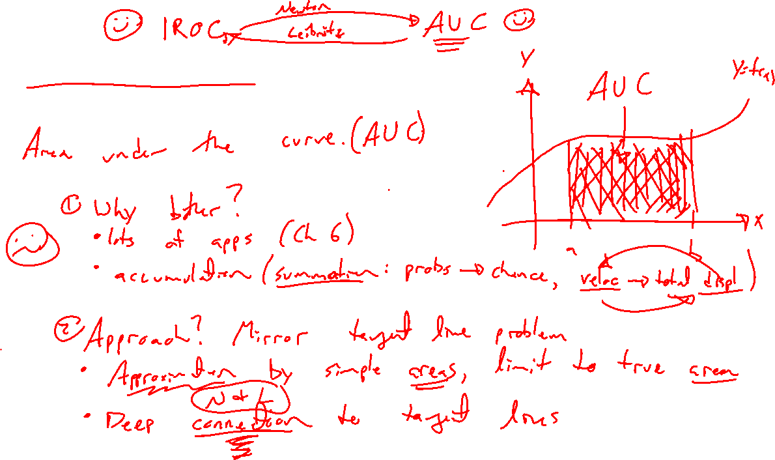
Second paradox of calculus
Notes:
Area under the curve.
Same approach as with tangent line, approximation, limiting process, indet form. Again limit is key.
Deep connection to derivative.
Lots of applications (accumulation), calc 2 gives full story.

Slide 3
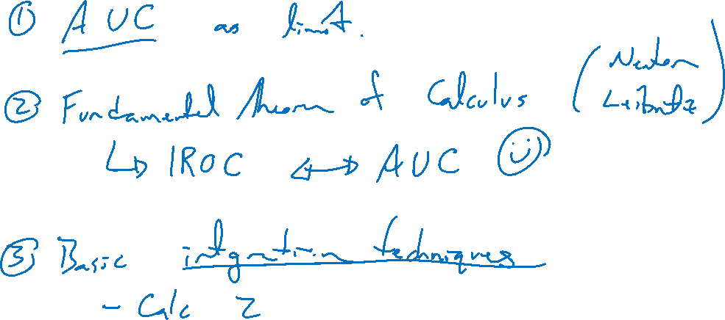
Outline of Chapter
Notes:
Area under curve.
FTOC
Basic integration techniques.

